Slide 1

Four Notions of Resilience (And why it matters)
Dr. David L. Alderson
Dr. Daniel A. Eisenberg
Operations Research Department
Center for Infrastructure Defense
Naval Postgraduate School, Monterey, CA
April 2024

Slide 2

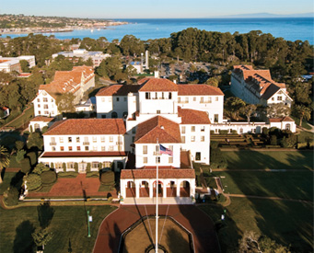
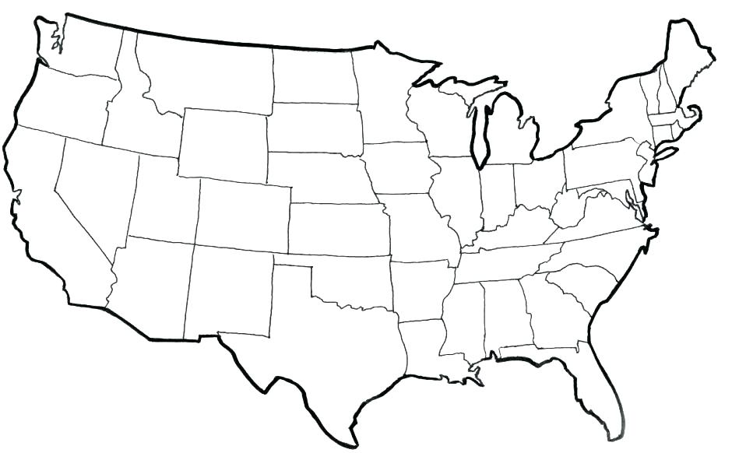

Where science meets the art of warfare
www.nps.edu
History Highlights
1909 | Founded at U.S. Naval Academy
1951 | Moved to Monterey, CA Operations Research curriculum established
Facilities of a graduate research university
Faculty who work for the U.S. Navy, with clearances
Students with fresh operational experience
FY2021/22:
500 faculty
1400 resident students (incl. 170 international)
715 Distance Learning students
10,000+ Exec Ed / Professional Dev students
Approx. $100M in sponsored research funding
2

Slide 3
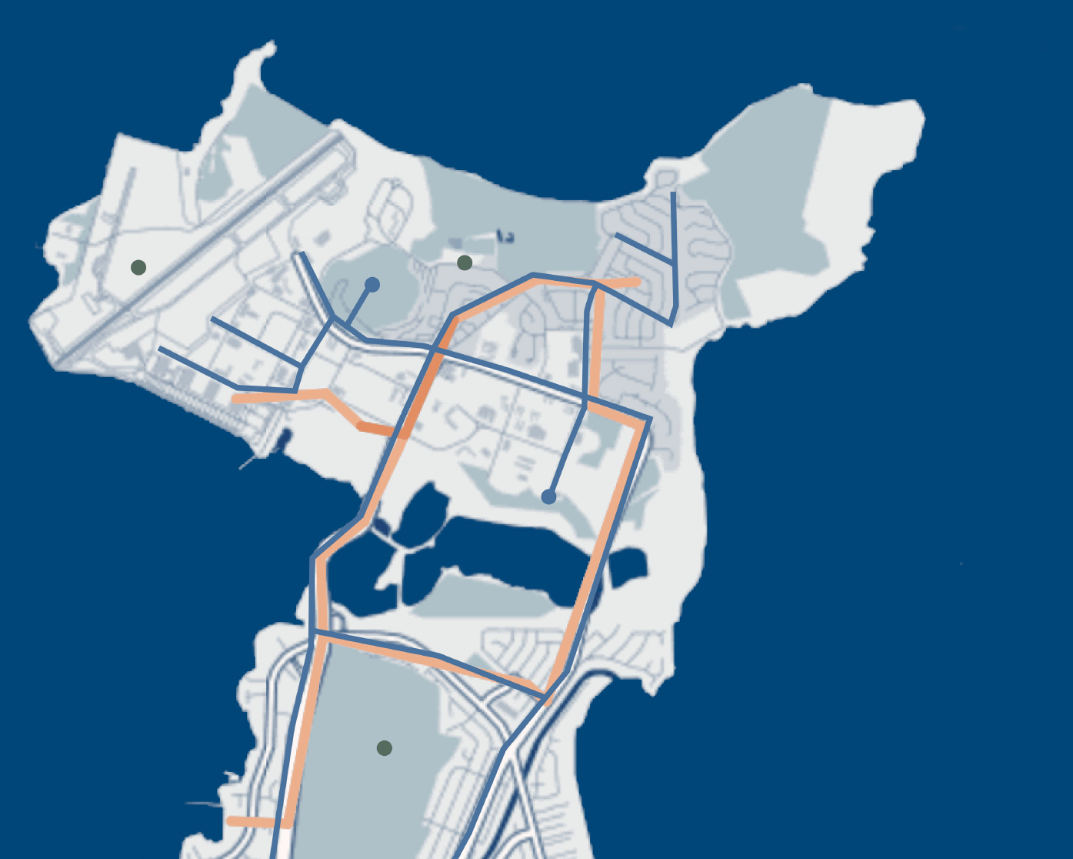
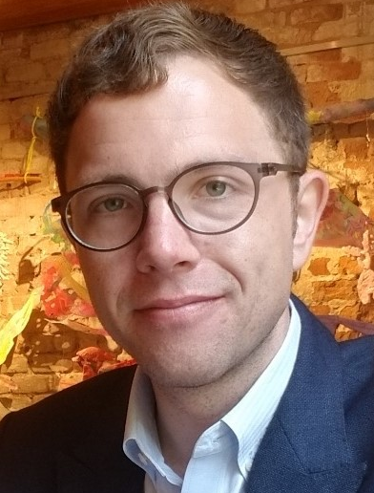
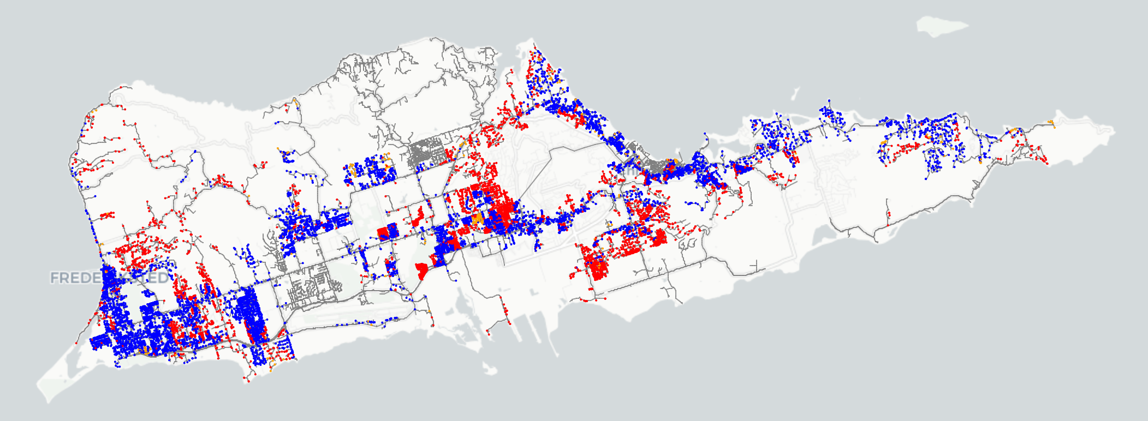

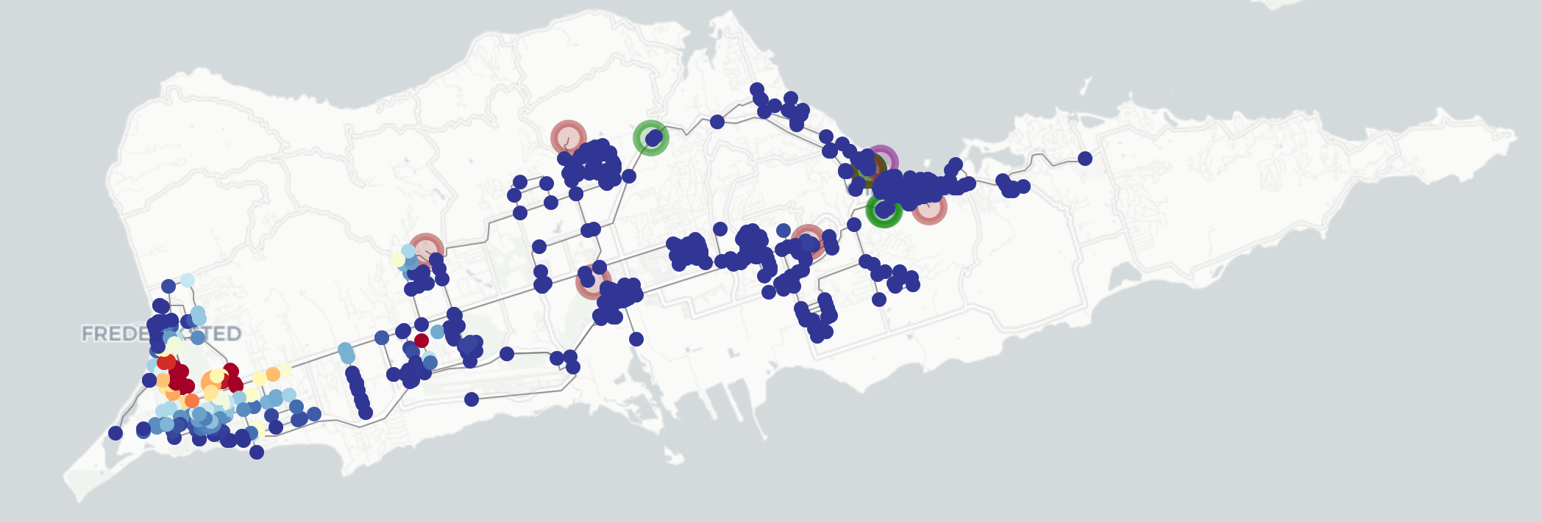

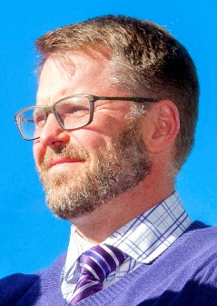
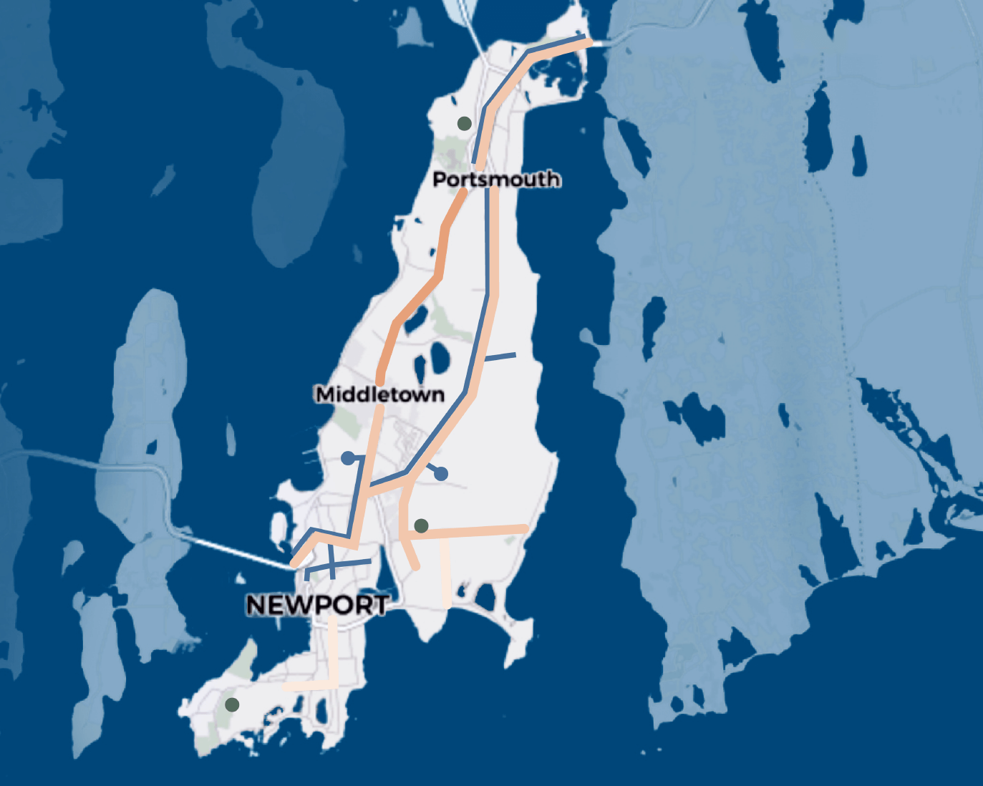
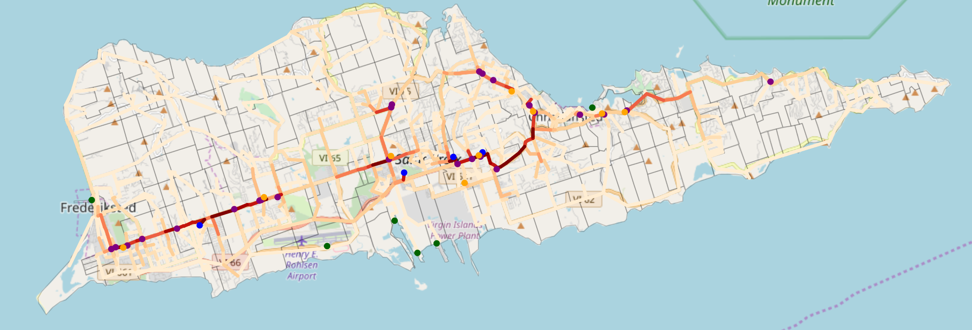


www.nps.edu/cid
Director
Dr. Daniel Eisenberg
Assistant Professor, Operations Research
Ph.D., Arizona State University, 2018
Research Sponsors
CIRCA - MCBH Kāne'ohe Bay
Executive Director
Dr. David Alderson
Professor, Operations Research
Ph.D., Stanford University, 2003
St. Croix, US Virgin Islands
CIRCA – NAVSTA Newport
The Center for Infrastructure Defense (CID) focuses on the continued operation of critical military and civilian infrastructure in the presence of failure, natural disaster, attack, and surprise.

Slide 4
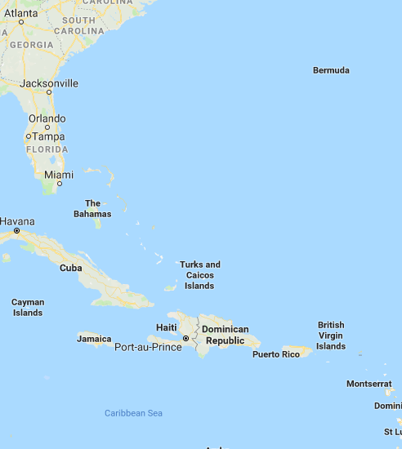
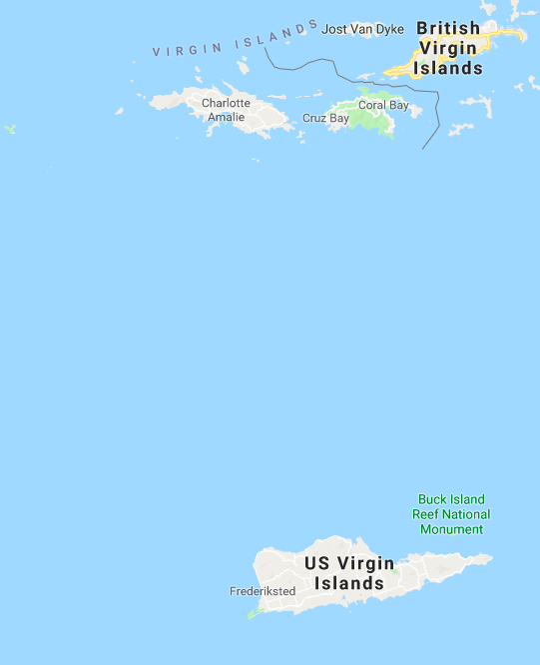
The US Virgin Islands &
The 2017 Hurricane Season
St. Thomas
St. John
St. Croix

Slide 5
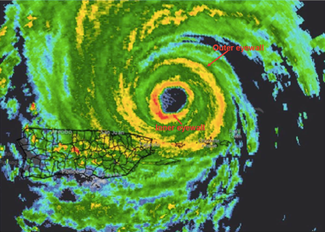
The US Virgin Islands &
The 2017 Hurricane Season
Irma
Sep 6-7
Irma
St. Thomas
St. John
St. Croix

Slide 6
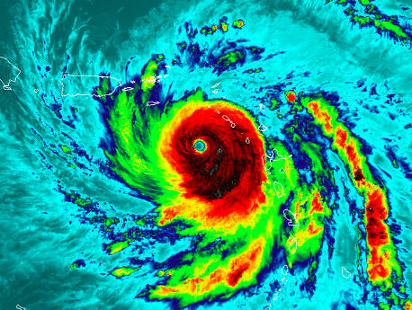
The US Virgin Islands &
The 2017 Hurricane Season
Irma
Sep 6-7
Irma
St. Thomas
St. John
Maria
St. Croix
Maria
Sep 20

Slide 7
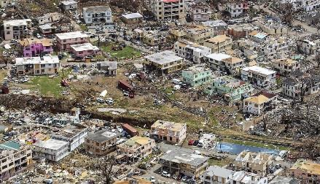
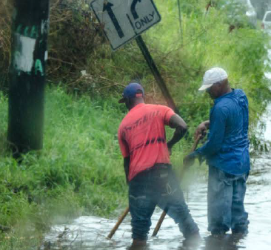
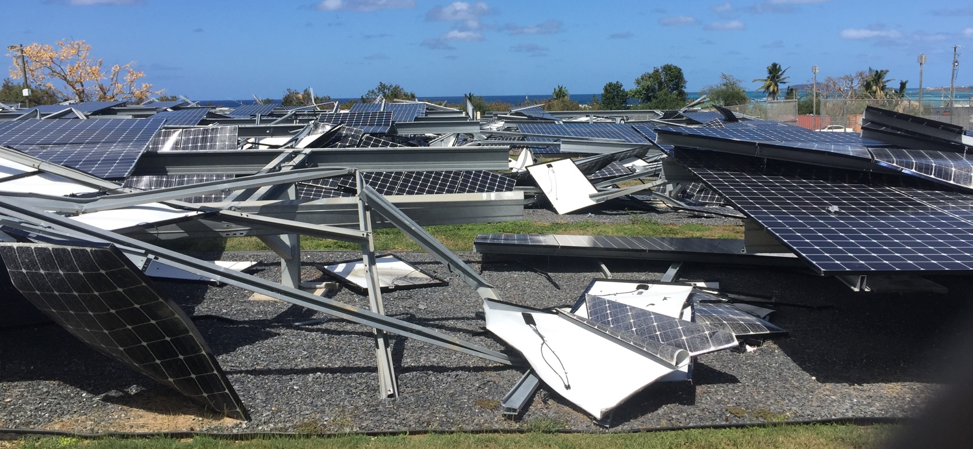
Following Hurricanes Irma and Maria
NPS was asked by FEMA to help if we could
Notes:
Total Damage
660,000 tons of debris on roads and other surfaces
10-20 inches of rainfall created
Imposed curfews limiting peoples ability to get supplies!!!!

Slide 8
Four Notions of Resilience*
Rebound from traumatic events
Robust in the ability to adapt from well-modeled disruptions
Graceful Extensibility = the capacity to stretch/extend near and beyond system boundaries
Sustained Adaptability = manage adaptive capacities (via architectures, rules of governance) near hard limits in tradeoff spaces
* D.D. Woods, 2015, “Four concepts for resilience and the implications for the future of resilience engineering,” Reliability Engineering and System Safety 141: 5-9.
See also
Sharkey TC, Nurre Pinkley SG, Eisenberg DA, Alderson DL. "In search of network resilience: An optimization-based view," Networks. 2020;1-30. https://doi.org/10.1002/net.21996
8

Slide 9
Four key concepts of resilience
Pre-Event
Stressful Event
Post-Event
Time
1. Robustness:
System continues to function as intended
3. Extensibility:
System function stretches to support new needs
2. Rebound:
System returns to previous function
4. Adaptability: System changes to function in new ways
Woods, David D. "Four concepts for resilience and the implications for the future of resilience engineering." Reliability Engineering & System Safety 141 (2015): 5-9.
9

Slide 10
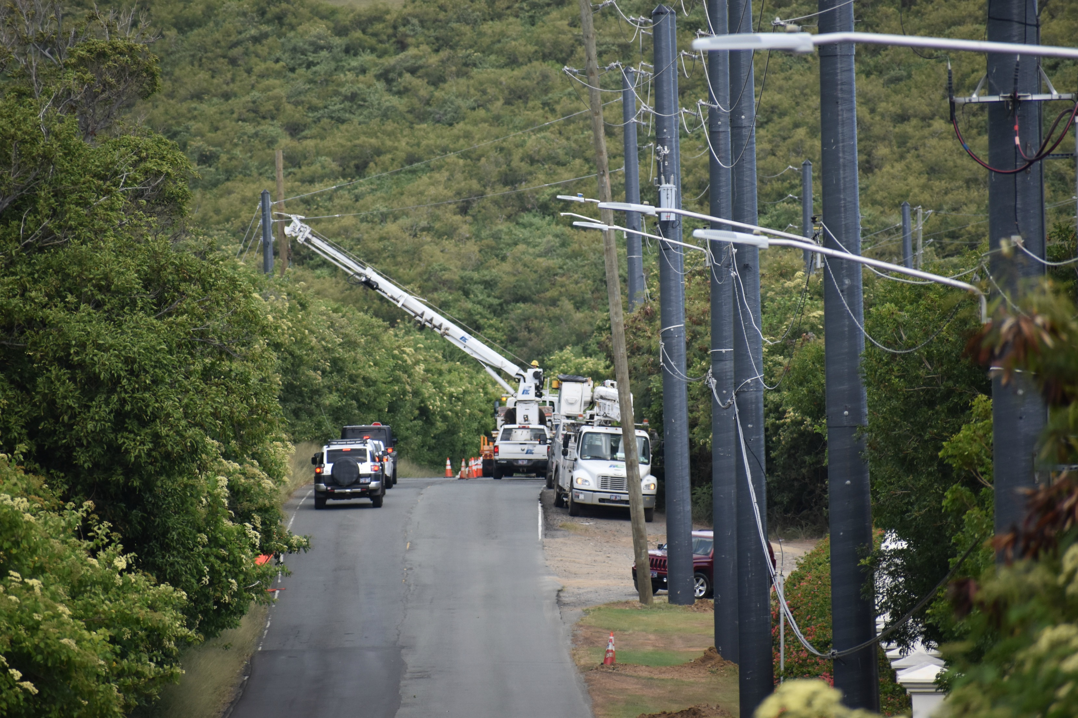
1. Robustness:
Composite Power Poles
https://viconsortium.com/VIC/?p=76179
10

Slide 11
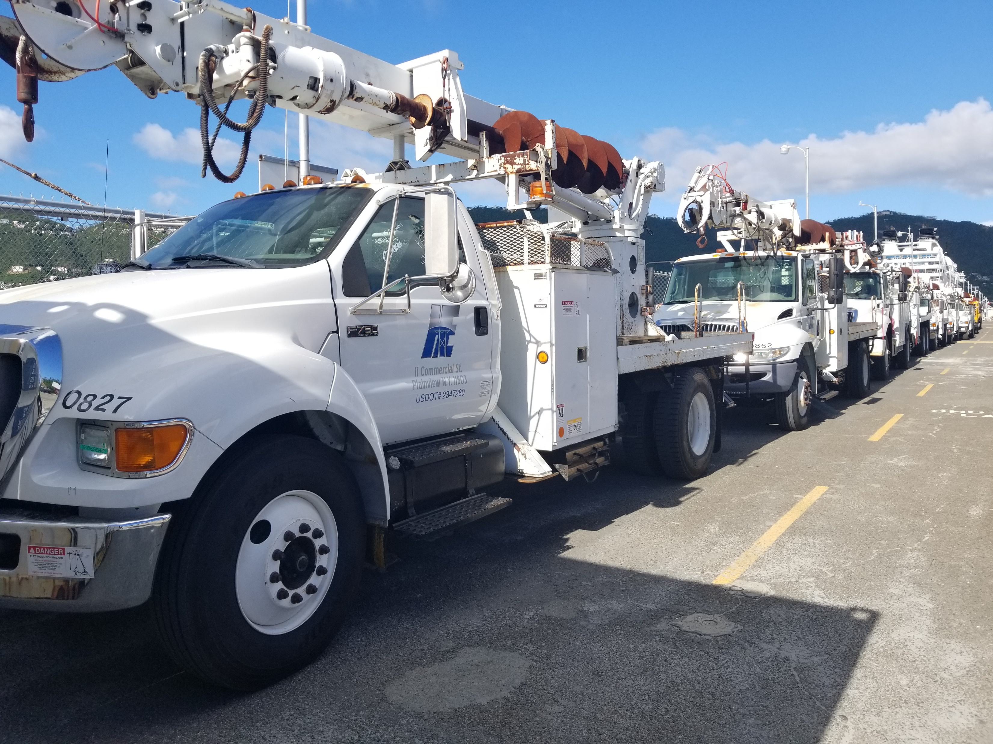
2. Rebound:
Deployable Line Crews
https://www.hauglandgroup.us/projects/
11

Slide 12
Four key concepts of resilience
Pre-Event
Stressful Event
Post-Event
Time
1. Robustness:
System continues to function as intended
3. Extensibility:
System function stretches to support new needs
2. Rebound:
System returns to previous function
4. Adaptability: System changes to function in new ways
Woods, David D. "Four concepts for resilience and the implications for the future of resilience engineering." Reliability Engineering & System Safety 141 (2015): 5-9.
12

Slide 13
Four key concepts of resilience
Pre-Event
Stressful Event
Post-Event
Time
1. Robustness:
System continues to function as intended
3. Extensibility:
System function stretches to support new needs
2. Rebound:
System returns to previous function
4. Adaptability: System changes to function in new ways
Even if we prepare in this way, we will be surprised…
Woods, David D. "Four concepts for resilience and the implications for the future of resilience engineering." Reliability Engineering & System Safety 141 (2015): 5-9.
13

Slide 14
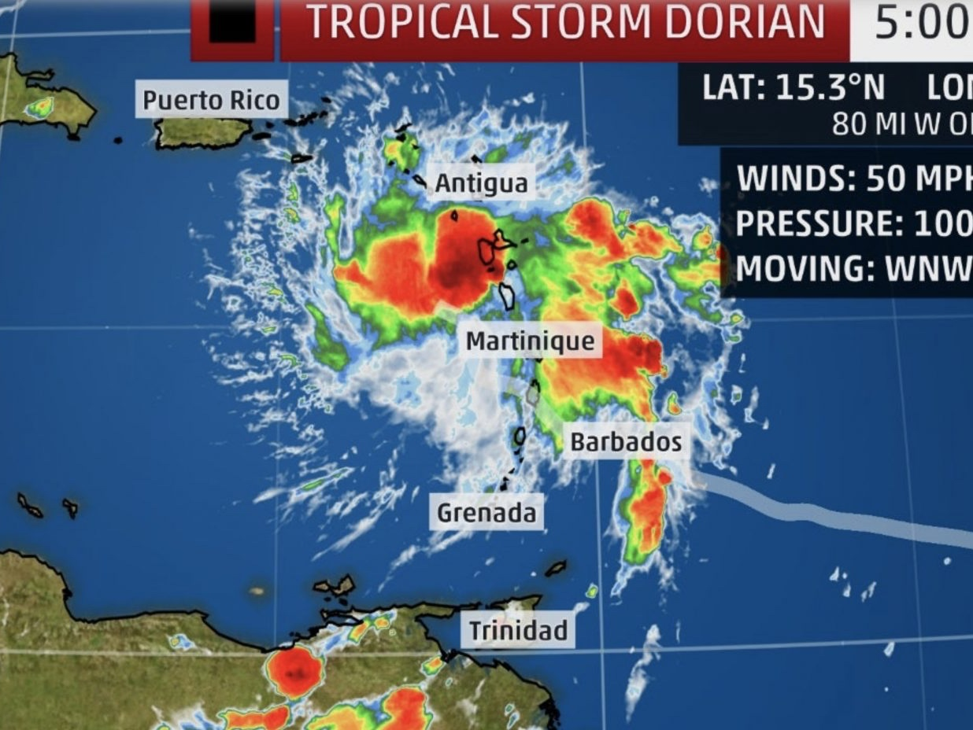
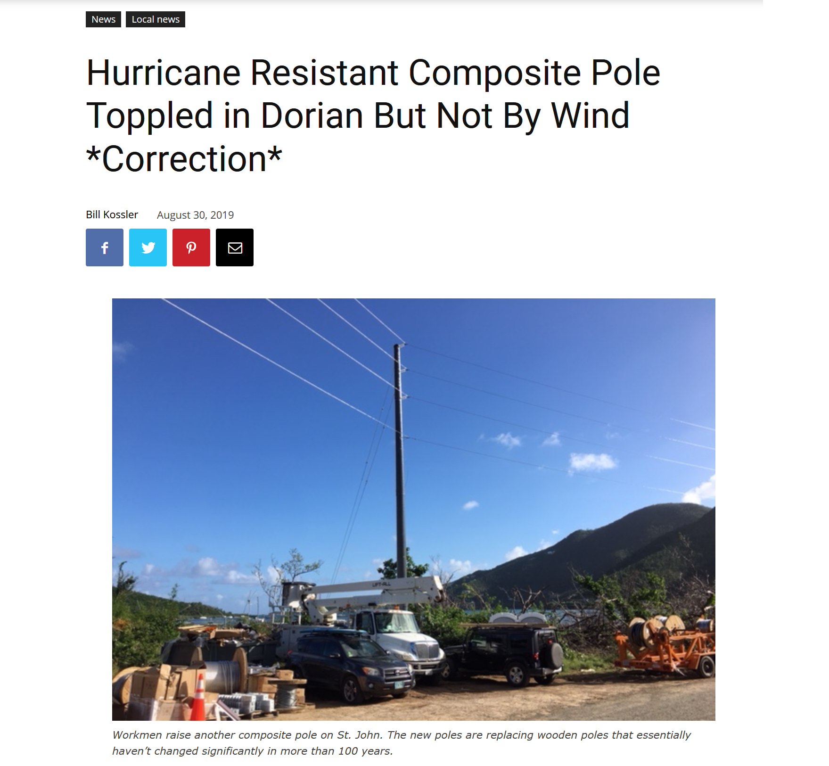
Surprise
Happens…
https://viconsortium.com/VIC/?p=77910

Slide 15
Four key concepts of resilience
Pre-Event
Stressful Event
Post-Event
Time
1. Robustness:
System continues to function as intended
3. Resilient systems Extend:
System function stretches to support new needs
2. Rebound:
System returns to
previous function
4. Resilient systems Adapt:
System changes to
function in new ways
“Keep things the same”
“Embrace the new”
Woods, David D. "Four concepts for resilience and the implications for the future of resilience engineering." Reliability Engineering & System Safety 141 (2015): 5-9.
15

Slide 16
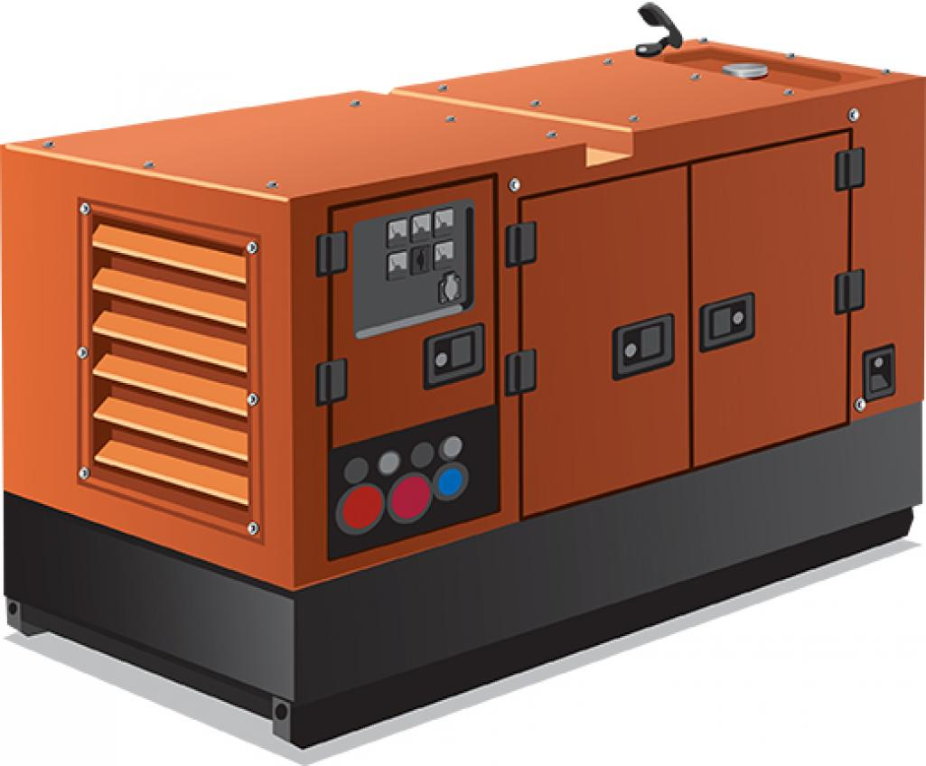
3. Extending function:
e.g., Emergency Generators
Does having an emergency generator make you resilient?
https://www.ecmag.com/section/your-business/backup-generators-anew
16

Slide 17
3. Extending function:
e.g., Emergency Generators
Does having an emergency generator make you resilient?
Not if you don’t have fuel
Not if you don’t know how to use it
Not if you have not maintained it
https://www.ecmag.com/section/your-business/backup-generators-anew
17

Slide 18
3. Extending function:
e.g., Emergency Generators
Does having an emergency generator make you resilient?
Not if you don’t have fuel
Not if you don’t know how to use it
Not if you have not maintained it
Key Idea
Resilience is not what you have
Resilience is what you do
Think of resilience as a verb, not a noun!
https://www.ecmag.com/section/your-business/backup-generators-anew
18

Slide 19
3. Extending function:
e.g., Emergency Generators
Does having an emergency generator make you resilient?
Not if you don’t have fuel
Not if you don’t know how to use it
Not if you have not maintained it
Key Idea
Resilience is not what you have
Resilience is what you do
Think of resilience as a verb, not a noun!
https://www.ecmag.com/section/your-business/backup-generators-anew
resiliency
19

Slide 20








3. Extending function:
e.g., Emergency Generators
4. Adapting the system:
Re-configuration of components
Solar panels
Wind turbines
Batteries
Microgrids
https://www.ecmag.com/section/your-business/backup-generators-anew
20

Slide 21
Four key concepts of resilience
Pre-Event
Stressful Event
Post-Event
Time
1. Robustness:
System continues to function as intended
3. Resilient systems Extend:
System function stretches to support new needs
2. Rebound:
System returns to
previous function
4. Resilient systems Adapt:
System changes to
function in new ways
“Keep things the same”
“Embrace the new”
21

Slide 22
Key Messages
These four notions of resilience are distinct
They are not merely additive
There are tradeoffs between them
Focusing on one can leave to us blind to the others
Investing in one might come at the expense of another
We should be aware of these tradeoffs
Beware of simple scoring mechanisms

Slide 23
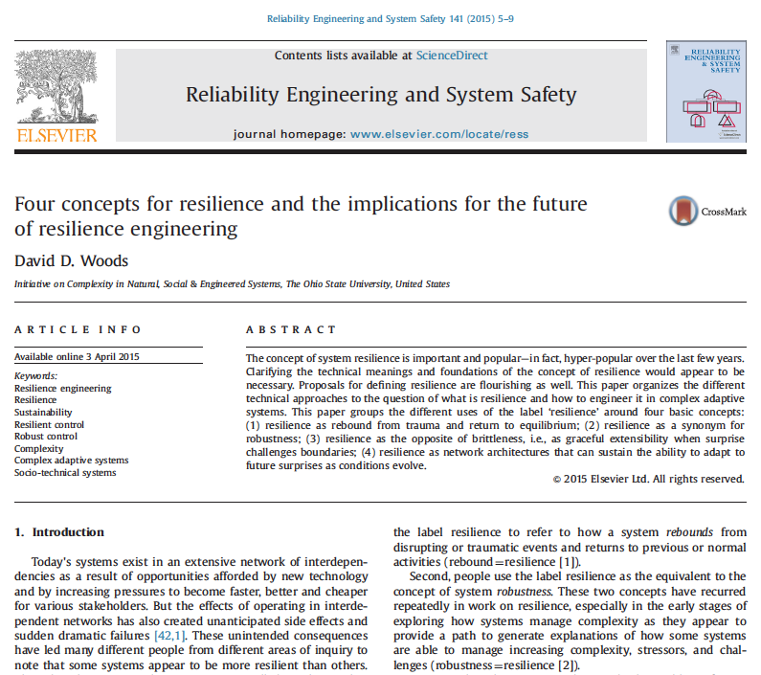
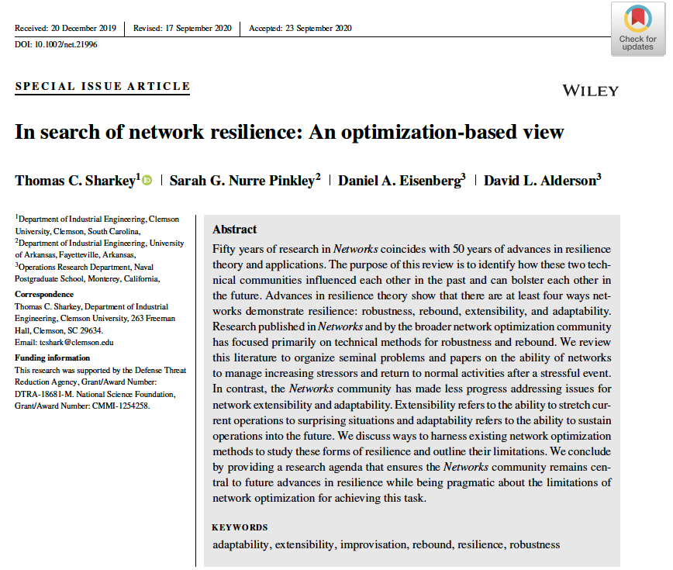
For more information

Slide 24
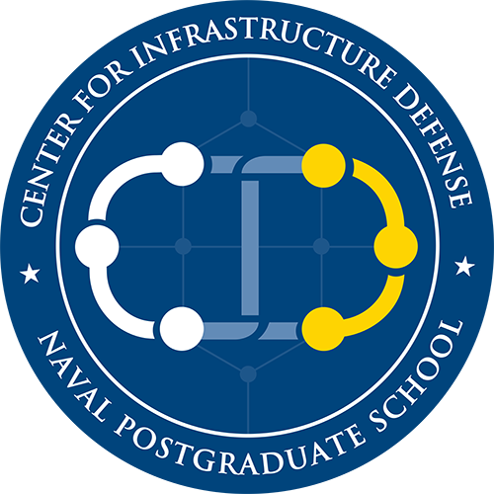



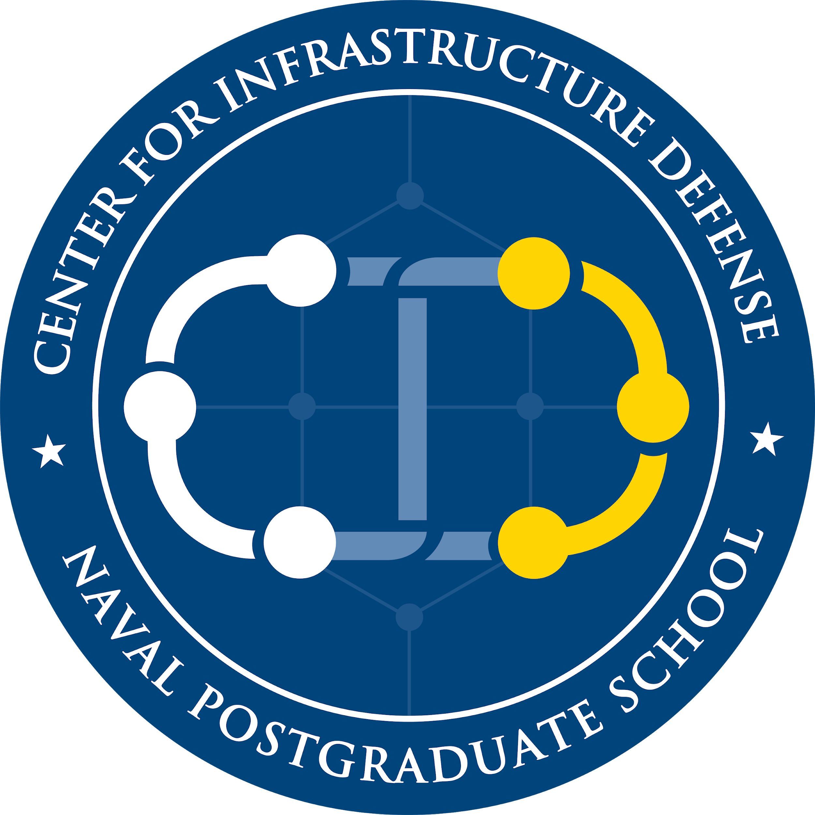
Contact Information
Daniel Eisenberg (daniel.eisenberg@nps.edu)
Director | Center for Infrastructure Defense (https://www.nps.edu/cid)
Assistant Professor | Operations Research
David Alderson (dlalders@nps.edu)
Executive Director | Center for Infrastructure Defense
Professor | Operations Research

